Slide 1

After Life
(Management of the dead and missing)
Lee, kyle Vincent v. reyes, Hannah mae e. mi – 141

Slide 2
Introduction
Management of the Dead and Missing Cluster
Response Team
An app that aims to help people search and identify missing persons and dead bodies

Slide 3
Current Process
Source: Pocket Emergency Tool of Department of Health
Search and Recovery Operation
Identification of the Dead
Final Arrangement for the Dead
Management of the Missing Persons
Management of Bereaved Families

Slide 4
Proposed Process
Identification of the Dead
Search Function
Management of the Missing Persons

Slide 5
Identification of the Dead
User fills up form
Admin validates the posts
User updates status of posts, if body was found
User fills up forms who wants to volunteer
User may read information of proper handling of dead bodies
User views list of near makeshift morgue
Admin requests for transportation of bodies
System summarizes all records

Slide 6
Search Function
Users can search for names of relatives/love ones

Slide 7
Management of the Missing Persons
User fills up missing person form
Admin validates the posts
User updates status of posts, if person was found
System summarizes all records

Slide 8
Objectives
Mission of the NDRRMC
To provide assistance in the proper identification and disposition of the remains in a sanitary manner with cautions to prevent negative psychological and social impact on the bereaved and the community.
App Objectives
To help identify people (dead, alive, missing, found)
To easily monitor dead/missing people
To have an organized search operation

Slide 9
Scope
Search Operation
Identification of the Dead and Missing
Summary of all Records (List of Identified and Unidentified)
Volunteer Form
Request for Transportation of Dead Bodies
List of emergency procedures
Validation of posts
News about dead/missing
List of Near Makeshift Morgues

Slide 10
Limitation
Management of the Bereaved Families
More on Psycho Spiritual Integration Cluster)
Internet-based
Final Arrangement for the Dead
Issuance of Death and Missing Certificates

Slide 11
Review Related Literature
Vesuvius (Sahana Foundation)
Google Person Finder

Slide 12
Features
Volunteers’ List and Form Inclusion
Proper Body Handling Manual
Summary of the Dead and Missing Statistics (Analytics)
Site News
Matchmaking of Data
List of Makeshift Morgue
Transportation Request

Slide 13
DESIGN OF PROTOTYPE

Slide 14
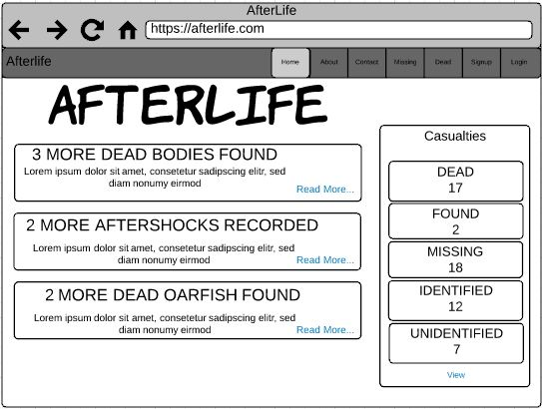

Slide 15
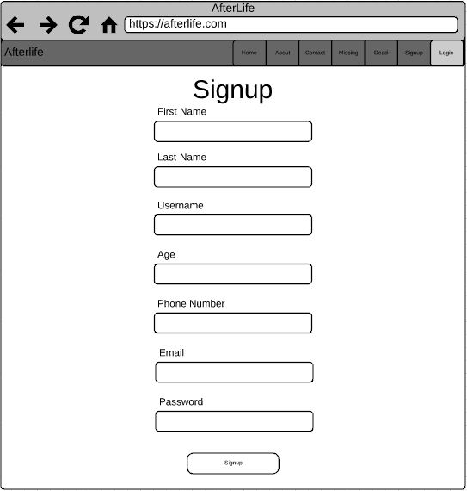

Slide 16
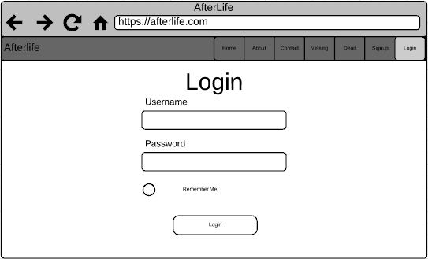

Slide 17
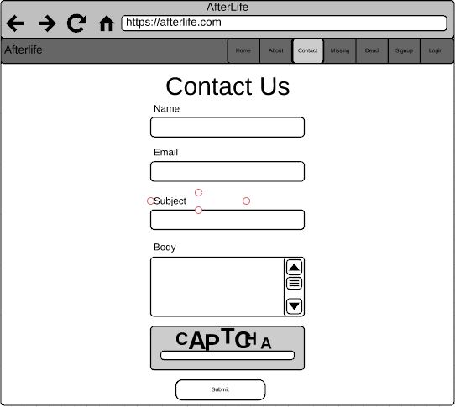

Slide 18
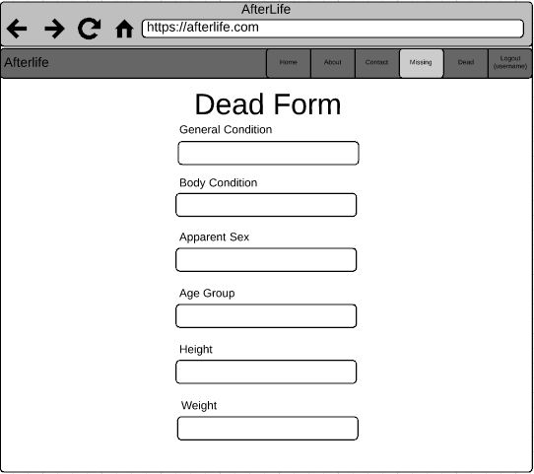

Slide 19
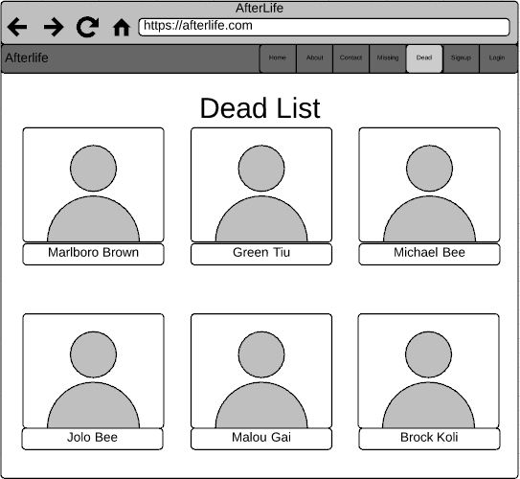

Slide 20
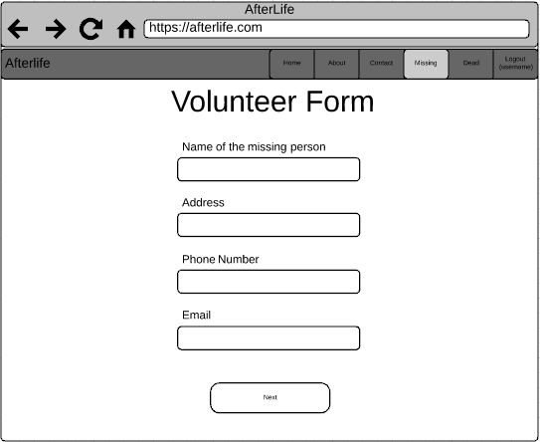

Slide 21
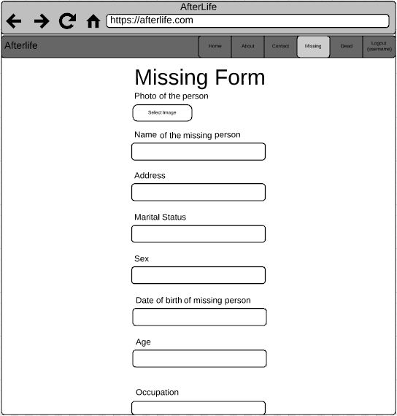

Slide 22
